Slide 1
Chapter 1:
Introduction to Advanced Topics on Web Engineering

Slide 2
1.1 Web Service
A simple definition:
“a Web Service is an application component accessible over open protocols”.
Web Services are evolving, middleware platform that facilitate program-to-program interactions.
A service is a software entity that can be discovered and invoked by other software systems
Definition from standardization body W3C
A Web service is a software system identified by a URI, whose public interfaces and bindings are defined and described using XML. Its definition can be discovered by other software systems. These systems may then interact with the Web service in a manner prescribed by its definition, using XML based messages conveyed by internet protocols

Slide 3
History
Web services evolved from previous technologies that served the same purpose such as RPC, ORPC (DCOM, CORBA and JAVA RMI).
Web Services were intended to solve three main problems:
Interoperability
Firewall traversal
Complexity

Slide 4
Interoperability
Earlier distributed systems suffered from interoperability issues because each vendor implemented its own on-wire format for distributed object messaging.
Development of DCOM apps strictly bound to Windows Operating system.
Development of RMI bound to Java programming language.

Slide 5
Firewall traversal
Collaboration across corporations was an issue because distributed systems such as CORBA and DCOM used non-standard ports.
Web Services use HTTP as a transport protocol and most of the firewalls allow access though port 80 (HTTP), leading to easier and dynamic collaboration.

Slide 6
Complexity
Web Services is a developer-friendly service system.
Most of the above-mentioned technologies such as RMI, COM, and CORBA involve a whole learning curve.
New technologies and languages have to be learnt to implement these services.

Slide 7
Web Services Components
XML – eXtensible Markup Language – A uniform data representation and exchange mechanism.
SOAP – Simple Object Access Protocol – A standard way for communication.
UDDI – Universal Description, Discovery and Integration specification – A mechanism to register and locate WS based application.
WSDL – Web Services Description Language – A standard meta language to described the services offered.

Slide 8
Example – A simple Web Service
A buyer (which might be a simple client) is ordering goods from a seller service.
The buyer finds the seller service by searching the UDDI directory.
The seller service is a Web Service whose interface is defined using Web Services Description Language (WSDL).
The buyer is invoking the order method on the seller service using Simple Object Access Protocol (SOAP) and the WSDL definition for the seller service.
The buyer knows what to expect in the SOAP reply message because this is defined in the WSDL definition for the seller service.

Slide 9
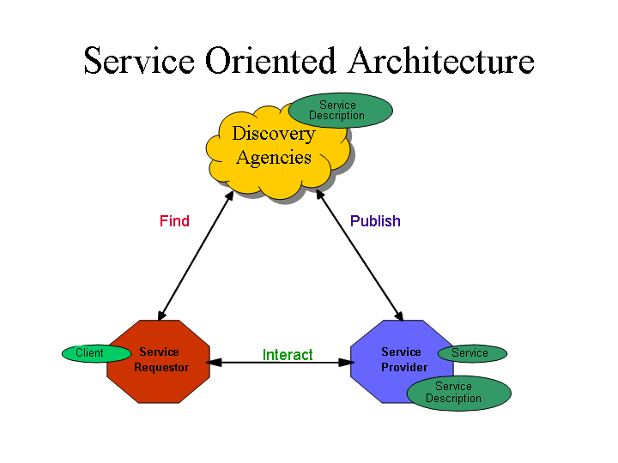
Web Services Basic Architecture
Web services are consistent with established Service-Oriented Architecture(SOA) principles.
Web Services Component
Service
Service Description
Web services Roles
Service providers.
Service brokers
Service requestors.
Web Services Operations
Publishing – making a service available
Finding – locating web services
Binding – using web services

Slide 10
1.2. Semantic Web Overview
The Semantic Web is a major research initiative of the World Wide
Web Consortium (W3C) to create a metadata-rich Web of resources
that can describe themselves not only by how they should be
displayed (HTML) or syntactically (XML), but also by the meaning of the metadata.”
“The Semantic Web is an extension of the current web in which
information is given well-defined meaning, better enabling computers
and people to work in cooperation.”

Slide 11
Resource Description Framework (RDF) - I
Resource Description Framework (RDF) is a framework for
describing and interchanging metadata (data describing the web
resources).
RDF provides machine understandable semantics for metadata.
This leads,
better precision in resource discovery than full text search,
assisting applications as schemas evolve,
interoperability of metadata.

Slide 12
Resource Description Framework (RDF) - II
RDF has following important concepts
Resource : The resources being described by RDF are anything that can be named via a URI.
Property : A property is also a resource that has a name, for instance Author or Title.
Statement : A statement consists of the combination of a Resource, a Property, and an associated value.

Slide 13

1.3.What is RSS and Atom all about?
- They are a form of communication using XML documents to broadcast information updates to a large group of subscribers.
How it works and its benefit.
Before RSS and Atom
Favorite website A
Favorite website B
Favorite website C
Notes:
Before: User must visit all sites on a regular bases to check for changes.

Slide 14
After RSS and Atom
Favorite website A
Reader or Aggregator
Application
Favorite website B
Favorite website C
Notes:
After: servers (websites) send information to aggregator when changes or additions are made. (In Theory) In practices, reader app checks subscribed sites for changes at set time intervals and alerts users to new information in a feed panel. Difference between push and pull delivery system.

Slide 15
1.4. Captcha
A CAPTCHA (an acronym for "Completely Automated Public Turing test to tell Computers and Humans Apart") is a type of challenge-response test used in computing to determine whether or not the user is human.
Some CAPTCHA requires that the user type the letters of a distorted image, sometimes with the addition of an obscured sequence of letters or digits that appears on the screen. Because the test is administered by a computer, in contrast to the standard Turing test that is administered by a human.

Slide 16
1.5. Workflow Languages
It is languages for describing or specifying workflows or workflow language for short enter the picture.
Workflow languages aim at capturing workflow-relevance information of application processes with the aim of their controlled execution by workflow management system.
Work flow languages are yet another species of languages for human-computer interaction. In contrast to general-purpose programming languages, workflow languages are highly domain specific, i.e., they are tailored towards the specific needs of workflow application

